Slide 1
Problems on Trains

Slide 2
Type 1:
Crossing a Stationary Object that
does not have any length.
Examples:
A Tree
An Electric pole
A Milestone
A Lamp post
A Standing man

Slide 3


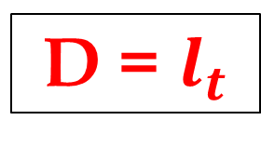
Variables in Type -1 Problems
$$l_{t}$$
=
m
$$S_{t}$$
=
km/h
T
=
sec
D = $l_{t}$

Slide 4
Type 1 - Questions

Slide 5
Q.1)
A train 280 m long, running with speed of 63 km/h will pass an electric pole in :
a)20 sec b)16 sec
c)15 sec d)18 sec

Slide 6


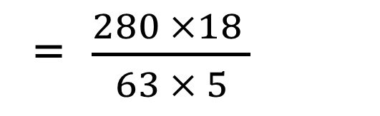
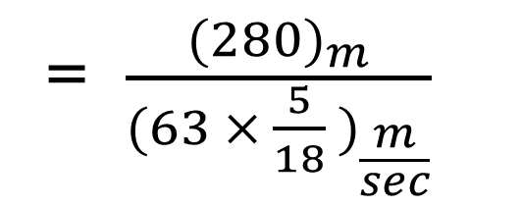
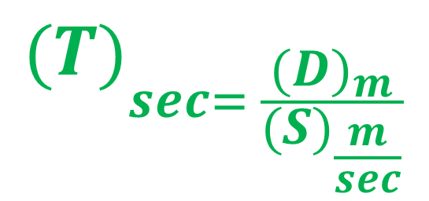
Q.1)Explanation
= $\frac{{(280)}_{m}}{{(63 × \frac{5}{18} )}_{\frac{m}{sec}}}$
$$l_{t}$$
=
280 m
$$S_{t}$$
=
63 km/h
T
=
? sec
= $\frac{280 ×18 }{63 × 5}$
$${(T)}_{sec= \frac{{(D)}_{m}}{{(S)}_{\frac{m}{sec}}}}$$
= 16 sec

Slide 7
Q.2)
A train travelling at a speed of 90 km/h, crosses a tree in 10 sec, then the length of the train is:
a)250 m b)150 m
c)350 m d)100 m

Slide 8
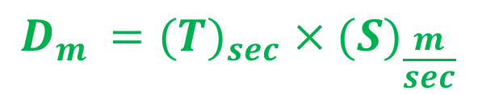
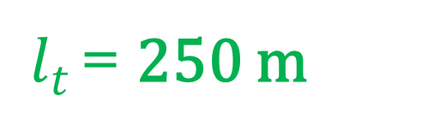
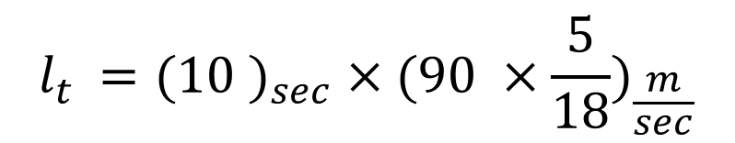
Q.2)Explanation
$$l_{t}$$
=
(?) m
$$S_{t}$$
=
90 km/h
$$l_{t }={(10 )}_{sec} ×{(90 ×\frac{5}{18})}_{\frac{m}{sec}}$$
T
=
10 sec
$$D_{m }={(T)}_{sec} ×{(S)}_{\frac{m}{sec}}$$
$l_{t }$= 250 m

Slide 9
Type 2:
Crossing a Stationary Object that is having some length.
Examples:
A Platform
A Bridge
A Tunnel
A Standing Train

Slide 10

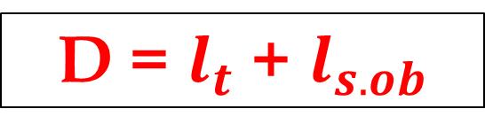
Variables in Type -2 Problems
$$l_{t}$$
=
m
$$l_{s.ob}$$
=
m
$$S_{t}$$
=
km/h
T
=
sec
D = $l_{t}$ + $l_{s.ob}$

Slide 11
Type 2 - Questions

Slide 12
Q.3)
A train is moving at a speed 132 km/h. If the length of the train is 110 m, then how long will it take to cross a railway platform 165 m long?
a)5 sec b)7.5 sec
c)10 sec d)15 sec

Slide 13

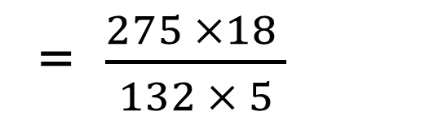

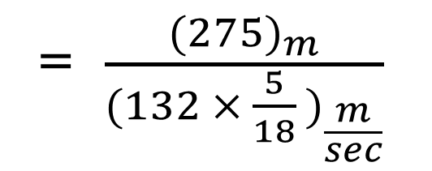
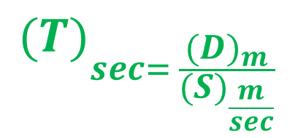

Q.3)Explanation
$$l_{t}$$
=
110 m
$$l_{P}$$
=
165 m
= $\frac{{(275)}_{m}}{{(132 × \frac{5}{18} )}_{\frac{m}{sec}}}$
$$S_{t}$$
=
132 km/h
T
=
(?)sec
= $\frac{275 ×18 }{132 × 5}$
$${(T)}_{sec= \frac{{(D)}_{m}}{{(S)}_{\frac{m}{sec}}}}$$
= 7.5 sec
D = 110 + 165
= 275 m

Slide 14
Q.4)
If a 200m long train crosses a platform of same length as that of the train in 20 sec. Then the speed of the train is:
a)50 km/h b)60 km/h
c)72 km/h d)80 km/h

Slide 15
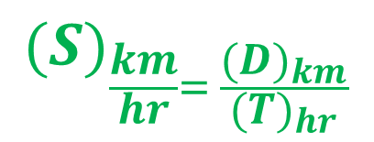
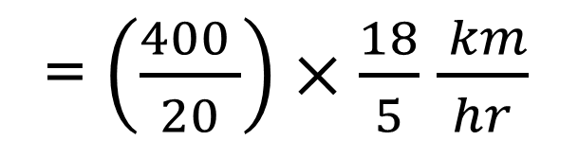
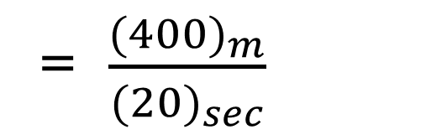
Q.4)Explanation
$$l_{t}$$
=
200 m
$$l_{P}$$
=
200 m
= $\frac{{(400)}_{m}}{{(20)}_{sec}}$
$$S_{t}$$
=
(?) km/h
T
=
20 sec
= $\left(\frac{400 }{20}\right)×\frac{18}{5}$ $\frac{ km}{hr}$
$${(S)}_{\frac{km}{hr}= \frac{{(D)}_{km}}{{(T)}_{hr}}}$$
= 72 km/h
D = 200 + 200
= 400 m

Slide 16
Type 3:
Crossing a Moving Object that
does not have any length.
Example:
Running Man

Slide 17

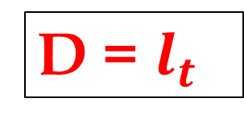
Variables in Type -3 Problems
$$l_{t}$$
=
m
$$S_{t}$$
=
km/h
$$S_{m}$$
=
km/h
T
=
sec
D = $l_{t}$
S = Relative Speed

Slide 18
Type 3 - Questions

Slide 19
Q.5)
A train 110 m long is running with a speed of 60 km/h. In what time will it pass a man who is running at 6 km/h in the direction opposite to that in which the train is going?
a)5 sec b)6 sec
c)7 sec d)10 sec

Slide 20

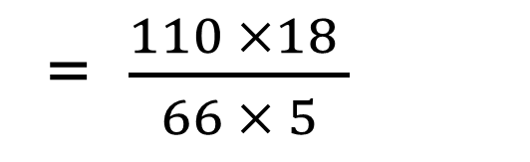
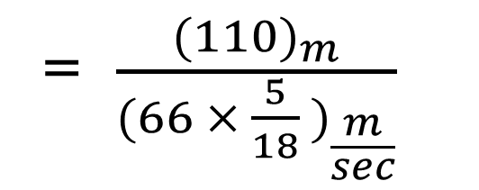

Q.5)Explanation
$$l_{t}$$
=
110 m
= $\frac{{(110)}_{m}}{{(66 × \frac{5}{18} )}_{\frac{m}{sec}}}$
$$S_{t}$$
=
60 km/h
$$S_{m}$$
=
6 km/h
T
=
(?)sec
= $\frac{110 ×18 }{66 × 5}$
$${(T)}_{sec= \frac{{(D)}_{m}}{{(S)}_{\frac{m}{sec}}}}$$
= 6 sec
D = 110 m
S = Rel. Sp =>( 60 + 6) = 66 km/h

Slide 21
Q.6)
A train of length 500 m takes 30 sec to cross a man who is walking with a speed of 3 km/h, in the same direction in which the train is moving. Find the speed of the train.
a)60 km/h b)63 km/h
c)58 km/h d)53 km/h

Slide 22
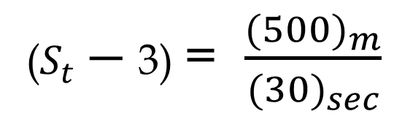

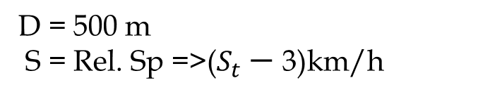
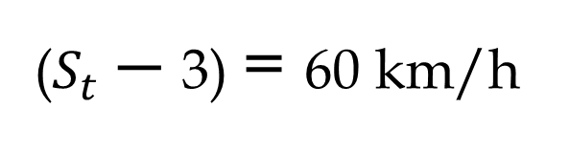
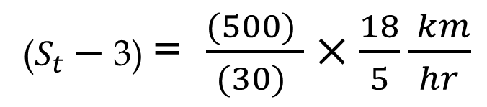
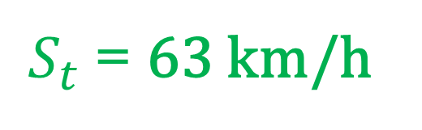
Q.6)Explanation
$$l_{t}$$
=
500 m
($S_{t}−$ 3) = $\frac{{(500)}_{m}}{{(30)}_{sec}}$
$$S_{t}$$
=
(?) km/h
$$S_{m}$$
=
3 km/h
T
=
30 sec
($S_{t}−$ 3) = $\frac{{(500)}_{ }}{{(30)}_{ }}×\frac{18}{5}\frac{ km}{hr}$
$${(S)}_{\frac{km}{hr}= \frac{{(D)}_{km}}{{(T)}_{hr}}}$$
($S_{t}−$ 3) = 60 km/h
D = 500 m
S = Rel. Sp =>($S_{t}−$ 3)km/h
$S_{t}$= 63 km/h

Slide 23
Type 4:
Crossing a Moving Object that is having some length.
Example:
A Moving Train

Slide 24




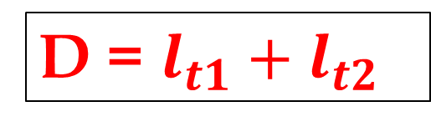
Variables in Type -4 Problems
$$l_{t1}$$
=
m
$$l_{t2}$$
=
m
$$S_{t1}$$
=
km/h
$$S_{t2}$$
=
km/h
T
=
sec
D = $l_{t1}+l_{t2}$
S = Relative Speed

Slide 25
Type 4 - Questions

Slide 26
Q.7)
Two trains 140 m and 160 m long running at a speed of 60 km/h and 40 km/h respectively in opposite direction on parallel tracks. Find the time taken to cross each other.
a)9 sec b)9.6 sec
c)10 sec d)10.8 sec

Slide 27


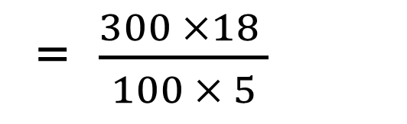

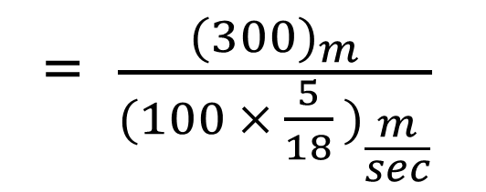

Q.7)Explanation
$$l_{t1}$$
=
140 m
$$l_{t2}$$
=
160 m
= $\frac{{(300)}_{m}}{{(100 × \frac{5}{18} )}_{\frac{m}{sec}}}$
$$S_{t1}$$
=
60 km/h
$$S_{t2}$$
=
40 km/h
T
=
(?)sec
= $\frac{300 ×18 }{100 × 5}$
$${(T)}_{sec= \frac{{(D)}_{m}}{{(S)}_{\frac{m}{sec}}}}$$
= 10.8 sec
D = 140 + 160 = 300 m
S = Rel. Sp =>( 60 + 40) = 100 km/h

Slide 28
Q.8)
Train A is running at a speed of 120 km/h crosses another train B, which is running in the same direction, on parallel track, in 2 min. If the lengths of the two trains be 100 m and 200 m respectively, then what was the speed of the train B?
a)111 km/h b)127 km/h
c)123 km/h d) 9 km/h

Slide 29

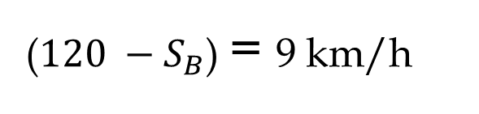
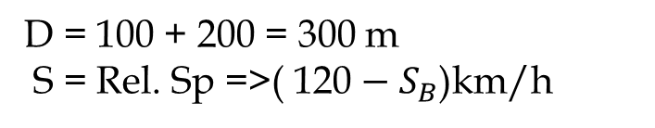
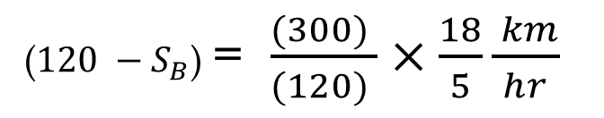

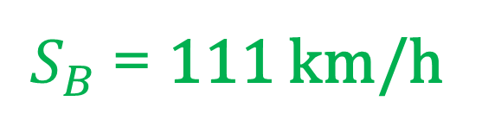

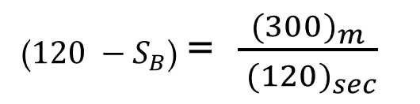

Q.8)Explanation
$$l_{A}$$
=
100 m
$$l_{B}$$
=
200 m
(${120 −S}_{B}$) = $\frac{{(300)}_{m}}{{ (120)}_{sec}}$
$$S_{A}$$
=
120 km/h
$$S_{B}$$
=
(?) km/h
(${120 −S}_{B}$) = $\frac{{(300)}_{ }}{{(120)}_{ }}×\frac{18}{5}\frac{ km}{hr}$
T
=
2 min
$${(S)}_{\frac{km}{hr}= \frac{{(D)}_{km}}{{(T)}_{hr}}}$$
(${120 −S}_{B}$) = 9 km/h
D = 100 + 200 = 300 m
S = Rel. Sp =>( 120 $−{ S}_{B}$)km/h
$S_{B}$= 111 km/h

Slide 30
Combination of Type 1 & 2 Problems

Slide 31
Q.9)
A 1200 m long train crosses a tree in 120 sec, how much time will it take to cross a platform 700 m long?
a)180 sec b)190 sec
c)170 sec d)175 sec

Slide 32
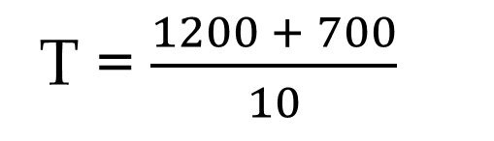






Q.9)Explanation
$$l_{t}$$
=
1200 m
$$l_{P}$$
=
700 m
T = $\frac{1200 + 700}{10}$
$$S_{t}$$
=
( ) m/s
T
=
(?) sec
________________________
T = 190 sec
$$l_{t}$$
=
1200 m
$$S_{t}$$
=
(? ) m/s
$S_{t}$ = $\frac{1200}{120}$ => 10 m/s
T
=
120 sec

Slide 33
Q.10)
A train passes a station platform in 36 seconds and a man standing on the platform in 20 seconds. If the speed of the train is 54 km/h, what is the length of the platform?
a)120 m b)240 m
c)300 m d)320 m

Slide 34
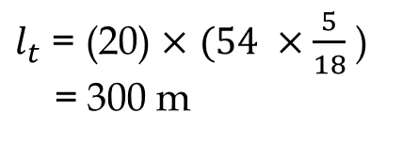
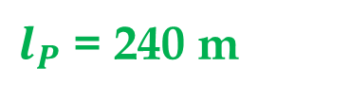
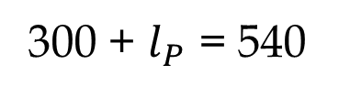
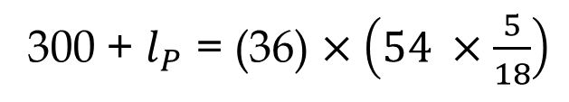
Q.10)Explanation
$$l_{t}$$
=
() m
$$l_{P}$$
=
(?) m
300 + $l_{P}$ = (36) $×\left(54 ×\frac{5}{18}\right)$
$$S_{t}$$
=
54 km/h
T
=
36 sec
________________________
300 + $l_{P}$ = 540
$$l_{t}$$
=
(?)m
$l_{P}$ = 240 m
$$S_{t}$$
=
54 km/h
$l_{t}$ = (20) $×$ $(54 ×\frac{5}{18}$ )
= 300 m
T
=
20 sec

Slide 35
Q.11)
A train crosses an electric pole in 15 seconds and a platform of 100 m long in 25 seconds. Find the length of the train.
a)100 m b)125 m
c)130 m d)150 m

Slide 36
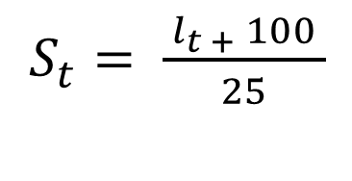
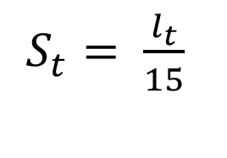


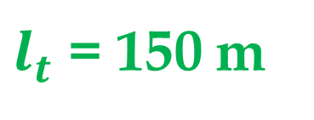

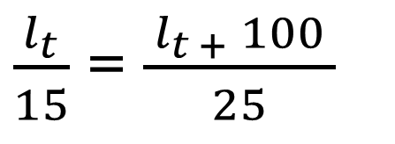
Q.11)Explanation
$$l_{t}$$
=
( ) m
$$l_{t}$$
100 m
=
( ) m
$$l_{P}$$
=
$$S_{t}$$
=
( ) m/s
$$S_{t}$$
=
( ) m/s
T
=
15 sec
T
=
25 sec
$S_{t}= \frac{l_{t}}{15}$
$S_{t}= \frac{{ l}_{t +} 100 }{25}$
$\frac{l_{t}}{15}$ = $\frac{{ l}_{t +} 100 }{25}$
$l_{t}$ = 150 m

Slide 37
Combination of Type 2 & 2 Problems

Slide 38
Q.12)
A train crosses a platform of 120 m in 15 sec, same train crosses of length 180 m in 18 sec. Then find the length of the train.
a)175 m b)180 m
c)185 m d)170 m

Slide 39
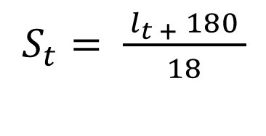
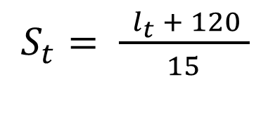



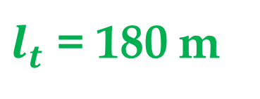

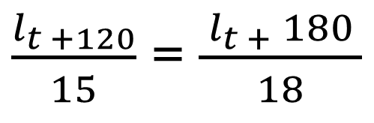
Q.12)Explanation
$$l_{t}$$
=
( ) m
$$l_{P}$$
=
120 m
$$l_{t}$$
180 m
=
( ) m
$$l_{P}$$
=
$$S_{t}$$
=
( ) m/s
$$S_{t}$$
=
( ) m/s
T
=
15 sec
T
=
18 sec
$S_{t}= \frac{{ l}_{t} + 120 }{15}$
$S_{t}= \frac{{ l}_{t +} 180 }{18}$
$\frac{l_{t +120}}{15}$ = $\frac{{ l}_{t +} 180 }{18}$
$l_{t}$ = 180 m

Slide 40
Q.13)
A train crosses a platform of 150 m in 15 sec, same train crosses of length 250 m in 20 sec. Then find the length of the train.
a)150 m b)165 m
c)155 m d)160 m

Slide 41
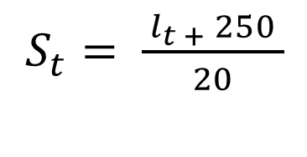
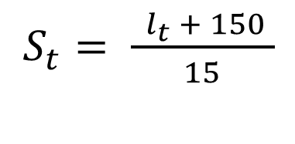

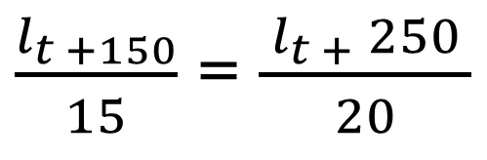
Q.13)Explanation
$$l_{t}$$
=
( ) m
$$l_{P}$$
=
150 m
$$l_{t}$$
250 m
=
( ) m
$$l_{P}$$
=
$$S_{t}$$
=
( ) m/s
$$S_{t}$$
=
( ) m/s
T
=
15 sec
T
=
20 sec
$S_{t}= \frac{{ l}_{t} + 150 }{15}$
$S_{t}= \frac{{ l}_{t +} 250 }{20}$
$\frac{l_{t +150}}{15}$ = $\frac{{ l}_{t +} 250 }{20}$
$l_{t}$ = 150 m

Slide 42
Combination of Type 3 & 3 Problems

Slide 43
Q.14)
A train overtakes two persons who are walking in the same direction in which the train is going, at the rate of 2 km/h and 4 km/h and passes them completely in 9 and 10 seconds respectively. The length of the train is:
a)72 m b)54 m c)50 m d)45 m

Slide 44
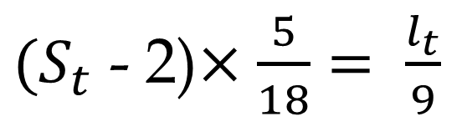



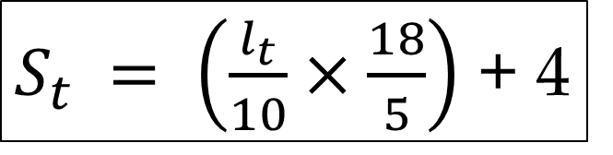

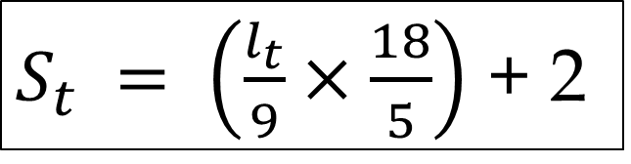

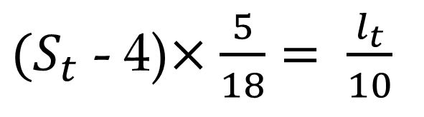
Q.14)Explanation
$$l_{t}$$
=
(?) m
$$l_{t}$$
=
(?) m
$$S_{t}$$
=
( ) km/h
$$S_{m}$$
=
2 km/h
$$S_{t}$$
=
( ) km/h
$$S_{m}$$
=
4 km/h
T
=
9 sec
T
=
10 sec
$(S_{t}$ - 2)$×\frac{5}{18}= \frac{l_{t}}{9}$
$(S_{t}$ - 4)$×\frac{5}{18}= \frac{l_{t}}{10}$
$S_{t} = \left(\frac{l_{t}}{9}×\frac{18}{5}\right)$ + 2
$S_{t} = \left(\frac{l_{t}}{10}×\frac{18}{5}\right)$ + 4

Slide 45




Q.14)Explanation…
$S_{t} = \left(\frac{l_{t}}{9}×\frac{18}{5}\right)$ + 2
$S_{t} = \left(\frac{l_{t}}{10}×\frac{18}{5}\right)$ + 4
$\left(\frac{l_{t}}{9}×\frac{18}{5}\right)\text{ + }2= \left(\frac{l_{t}}{10}×\frac{18}{5}\right)$ + 4
$l_{t}$ = 50 m

Slide 46


Q.14)Shortcut
$l_{t}$ = $\frac{\left(difference between 2 speeds\right) × (product of 2 time taken)}{differnce between 2 time taken}$
$l_{t}$ = $\frac{ \left(4 −2\right)× \frac{5}{18} × 9 × 10 }{10 − 9}$
$l_{t}$ = 50 m

Slide 47
Q.15)
A train overtakes two persons who are walking in the same direction in which the train is going, at the rate of 4 km/h and 8 km/h and passes them completely in 18 and 20 seconds respectively. The length of the train is:
a)100 m b)150 m c)200 m d)250 m

Slide 48




Q.15)Explanation
$$l_{t}$$
=
(?) m
$$l_{t}$$
=
(?) m
$$S_{t}$$
=
( ) km/h
$$S_{m}$$
=
4 km/h
$$S_{t}$$
=
( ) km/h
$$S_{m}$$
=
8 km/h
T
=
18 sec
T
=
20 sec
$(S_{t}$ - 4)$×\frac{5}{18}= \frac{l_{t}}{18}$
$(S_{t}$ - 8)$×\frac{5}{18}= \frac{l_{t}}{20}$
$S_{t} = \left(\frac{l_{t}}{18}×\frac{18}{5}\right)$ + 4
$S_{t} = \left(\frac{l_{t}}{20}×\frac{18}{5}\right)$ + 8

Slide 49




Q.15)Explanation…
$S_{t} = \left(\frac{l_{t}}{18}×\frac{18}{5}\right)$ + 4
$S_{t} = \left(\frac{l_{t}}{20}×\frac{18}{5}\right)$ + 8
$\left(\frac{l_{t}}{18}×\frac{18}{5}\right)\text{ + }4= \left(\frac{l_{t}}{20}×\frac{18}{5}\right)$ + 8
$l_{t}$ = 200 m

Slide 50


Q.15)Shortcut
$l_{t}$ = $\frac{\left(difference between 2 speeds\right) × (product of 2 time taken)}{differnce between 2 time taken}$
$l_{t}$ = $\frac{ \left(8 −4\right)× \frac{5}{18} ×18 ×20 }{20 −18}$
$l_{t}$ = 200 m

Slide 51
Q.16)
Two stations A and B are 110 km apart on a straight line. One train starts from A at 7 a.m. and travels towards B at 20 km/h. Another train starts from B at 8 a.m. and travels towards A at a speed of 25 km/h. At what they will meet each other?
a)9 a.m. b)10 a.m. c)11 a.m. d)10.30 a.m.

Slide 52
Q.17)
Two stations P and Q are 420 km apart on a straight line. One train starts from A at 6 a.m. and travels towards B at 40 km/h. Another train starts from B at 7.30 a.m. and travels towards A at a speed of 50 km/h. At what they will meet each other?
a)9.30 a.m. b)10 a.m. c)11 a.m. d)11.30 a.m.

Slide 53
Q.18)
A train starts from station P at 11 am and reaches station Q at 12 Noon. While an another train starts from station Q at 11 am and reaches station P at 12.30 pm. At what time these two trains will meet each other?
a)11.36 am b)11.42 am c)11.24 am d)11.50 am

Slide 54
Q.19)
A train starts from Chennai at 6 am and reaches Kovai at 11 am. While an another train starts from Kovai at 6 am and reaches Chennai at 1 pm. At what time these two trains will meet each other?
a)8.40 am b)9.30 am c)8.55 am d)7.30 am

